Slide 1
Server-side Programming
User logins

Slide 2



Websites often support authentication
Users
Groups
Restrict Access

Slide 3

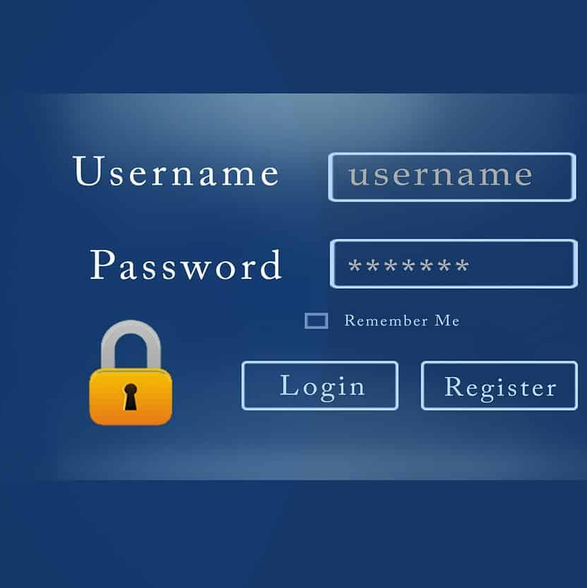

Authentication has 3 primary actions
Signup
Login
Logout

Slide 4
User info needs to be in the database
The database needs to keep track of the users and any metadata related to them
Email
Password
Name
Bio
Avatar
CREATE TABLE course_users (
id INTEGER
GENERATED BY DEFAULT ON NULL AS IDENTITY
PRIMARY KEY,
email VARCHAR2(100) NOT NULL,
password VARCHAR2(102) NOT NULL,
name VARCHAR2(1000) NOT NULL,
avatar_path VARCHAR2(2000)
);

Slide 5
Do not store plain text passwords
Recall from 331 the dangers of storing passwords in plain text directly in the database
Compromised database leaks passwords
Instead hash and salt passwords and store that result in the database
Hash is meaningless except for that particular user
Create password
Generate random salt
Enter plain text password
Check password
Enter plain text password
Read salt & hash
Hash salt & password
Store hash & salt
Has salt & provided password
Compare hashes

Slide 6
Werkzeug.security provides helpful password functions
Do not re-invent the wheel
Leverage existing libraries that are tested and secure to perform password hashing and checking
Flask comes with these functions in the wekzeug.security module
from werkzeug.security import check_password_hash, generate_password_hash
def create_hash(username, pwd):
hash = generate_password_hash(pwd)
get_db().create_user(username, hash)
def check_user(username, pwd):
hash = get_db().get_user_pwd(username)
return check_password_hash(hash, pwd)

Slide 7
Routes and db calls can handle creating the new user
To allow a user to signup, a template containing a form can be created
Database class can be modified to insert a new user in the database
A User object must be made as well
A route can be created to connect the DB and the Form
This is where the hashing can be performed
Create template
Create route
Create User object
Create form in template
Create DB call to add User
Connect everything in the route

Slide 8
Create a signup route
Create a users table in schema.sql
Must contain email, name, password
Create a user object in Python that matches the table in SQL
Add an auth_views.py containing a route for /auth/signup
Add a form that takes the necessary info and creates the account

Slide 9
flask_login handles the session details
Handling login can be more complicated than just checking the password
How long is the user logged in for?
Manage logout?
Remember me functionality?
flask_login library handles these details
pip install Flask-Login
…
from flask_login import LoginManager
... #__init__.py (inside create_app)
login_manager = LoginManager()
login_manager.login_view = 'auth.login'
login_manager.init_app(app)

Slide 10
User object needs to use the Flask-Login mixin
Flask-login needs to know about our User object
The User object needs to extend the UserMixin base class
By default, UserMixin looks for a field called id
Flask-login needs to know how to fetch a User for a given id
from flask_login import UserMixin
import os
class User(UserMixin):
…
@login_manager.user_loader
def load_user(user_id):
return get_db().get_user_id(int(user_id))

Slide 11
When logging in or out tell flask_login
Flask_login handles the users session
It provides a way to keep track of logins, logouts, and the current user making a request
Handles cookies and remember me behind the scenes
Has some requirements to work
Needs a User object that takes a UserMixin
Need to call login_user with that object
from flask_login import UserMixin
class User(UserMixin):
…
from flask_login import login_user
def login():
# Does work with forms
# Assume we have a valid user
user = get_db().get_user(email)
success = login_user(user, remember=remember)
if success:
return redirect(url_for('auth.profile'))
else:
flash("Unable to login please try again")
def logout():
logout_user()

Slide 12
Let’s code together
Setup Flask login
Create a route and template for login and logout
Use Flask-login to manage the user session

Slide 13
Routes can be protected based on a user
Flask-login manages the user session
It can protect routes such that only authenticated (logged-in) users can access them
@login_required provides this mechanism
@bp.route('/logout/')
@login_required
def logout():
logout_user()
return redirect(url_for('auth.login'))

Slide 14
Users need a profile
Users profile contains information about them
We can use good database design to connect the user to other data
Flask-login provides a variable called current_user
{% extends 'base.html' %}
{% block content %}
<h1>Profile</h1>
<h2>{{current_user.name}}</h2>

Slide 15
Let’s code together
Add login/signup and logout buttons to the base nav bar
Control which buttons are shown based on current_user

Slide 16
Storing images in a server
Uploading documents and returning them to the user

Slide 17



Uploading data to a server is common
Upload using a form
Save to the disk on the server
Render using a URL

Slide 18
Flask-WTF has a special FileField
Field comes from flask_wtf.file
Provides a way to upload a file
Html form needs to know that files are being uploaded
Add enctype="multipart/form-data“
from flask_wtf import FlaskForm
from flask_wtf.file import FileField
…
<form method="POST" action="" enctype="multipart/form-data">

Slide 19
Uploaded files need to be saved somewhere
Use a configuration variable to determine where to save the files
Leverage the instance path to create a unique folder for our flask server
Ensure the directories exist before saving files
def create_app(test_config=None):
# create and configure the app
app = Flask(__name__, instance_relative_config=True)
app.config.from_mapping(
SECRET_KEY='dev',
IMAGE_PATH=os.path.join(app.instance_path, 'images')
)
…
os.makedirs(app.instance_path)
os.makedirs(app.config['IMAGE_PATH'])

Slide 20
FileField data represents an open file
Accessing that data in the FileField gives us a file object
The filename can be obtained and the file itself can be saved
Os.path.join can be used to create a path to save the file
file = form.file.data
file_name = file.filename
path = os.path.join(current_app.config['IMAGE_PATH'], file_name)
file.save(path)

Slide 21
Flask needs to return the file to the browser with a URL
Flask has a built in function called send_from_directory that returns a file using a URL
It requires the path to the file
It needs a route to be called
Each file should map to a unique route
Use route variables for this
@bp.route('/avatars/<email>/<filename>')
@login_required
def send_file(email, filename):
return send_from_directory(os.path.join(current_app.config['IMAGE_PATH'], email), filename)

Slide 22
Let’s code together
Add a FileField to the signup form for images
Add configuration for saving images
Save the provided avatar image to disk
Create a route to show the image

Slide 23
Resources
FileField: https://flask-wtf.readthedocs.io/en/0.15.x/form/
Flask-Login: https://pypi.org/project/Flask-Login/

